Slide 1
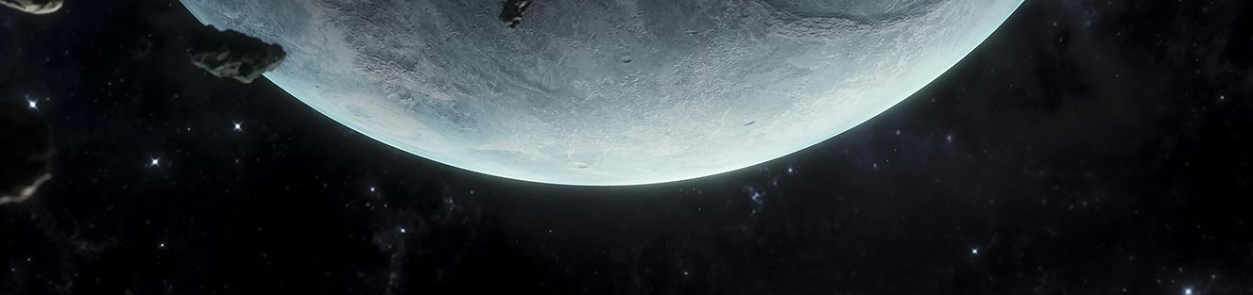

Team Wormhole_Travellers
By
NASA Challenge:
‘Habitable Exoplanets: Creating Worlds Beyond Our Own’
Location: Khulna

Slide 2





Team Wormhole_Travellers
Shamlima Deb Trena
Team Lead
B.Sc. in Computer Science & Engineering
Mohammad Jawadul Hoque Rohan
Business Analyst
B.Sc. in Industrial & Production Engineering
Al Amin
UI/UX Designer
B.Sc. in Computer Science & Engineering
Tanvir Ibne Hossain
Researcher
B.Sc. in Computer Science & Engineering
Faysal Mehrab Chowdhury
Developer
B.Sc. in Computer Science & Engineering

Slide 3
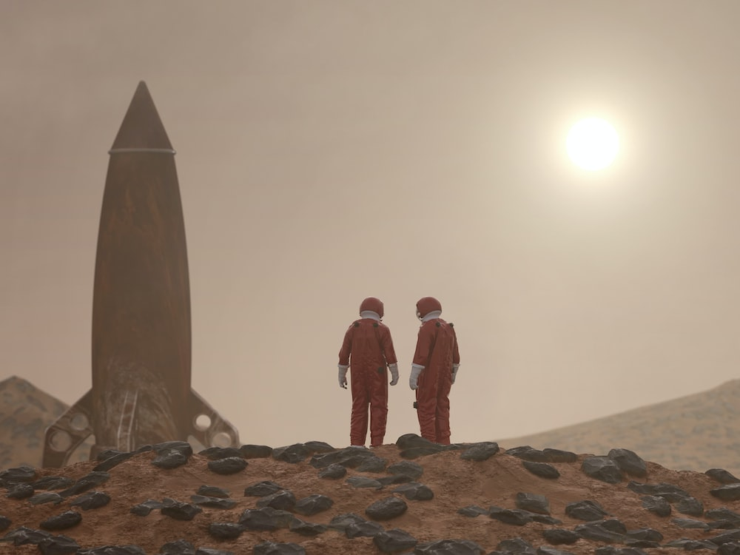

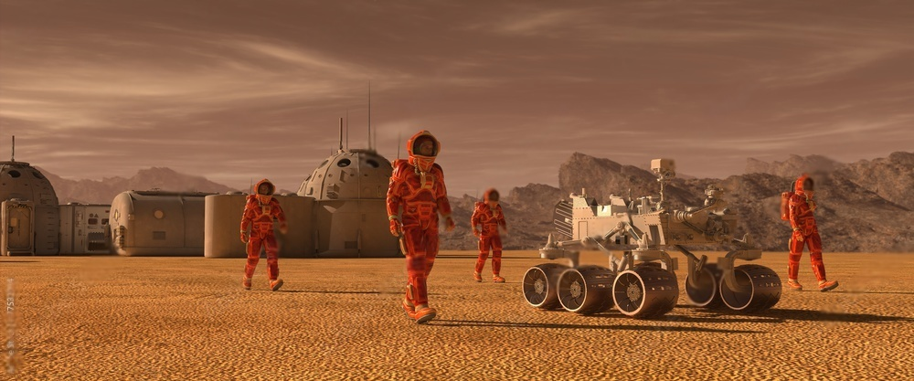
Why did we choose this?
Not enough engaging and interactive information about habitable exoplanets.
Complex data from space missions are challenging for the public to grasp.
Often misconceptions and myths about space and habitable planets.
Lack of public awareness and support for habitable exoplanets missions.

Slide 4

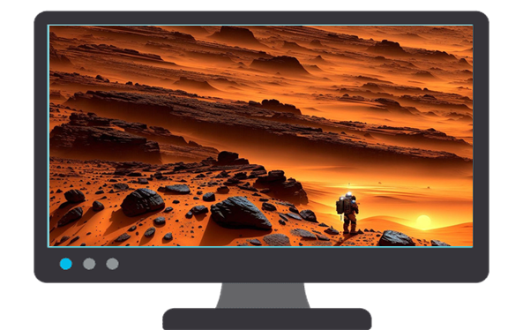
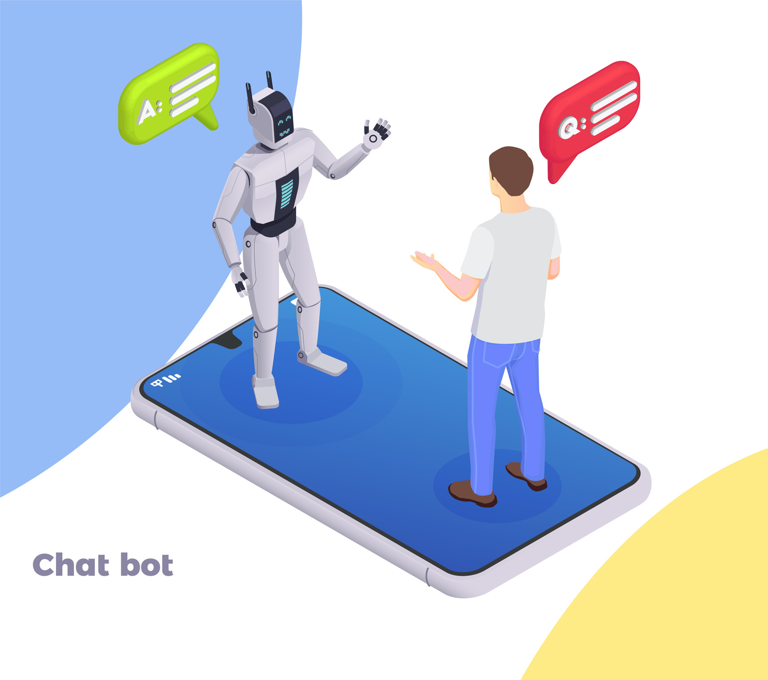
Solution
Our project will encourage thinking about the possibilities of life beyond Earth.
Can help educate people about the challenges of living on exoplanets, preparing them for the future possibility of colonization.
Exoplanet Visualization
Can help dispel the misconceptions by providing accurate information and promoting scientific understanding.
This project can serve as a bridge between space agencies and the general public, fostering interest and enthusiasm for future space missions.
ChatBot

Slide 5

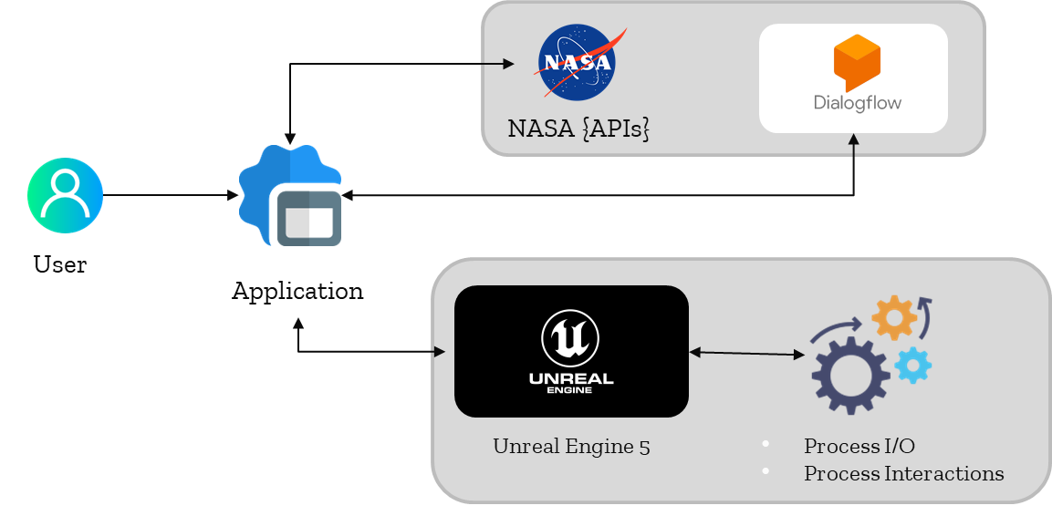
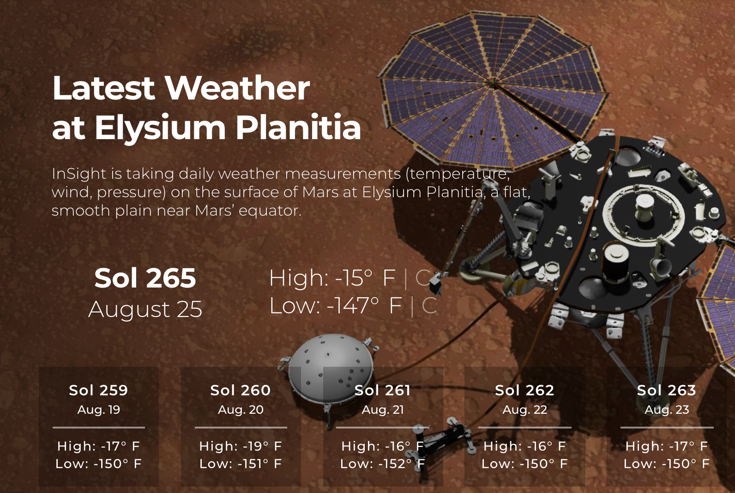

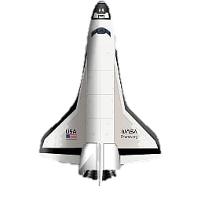
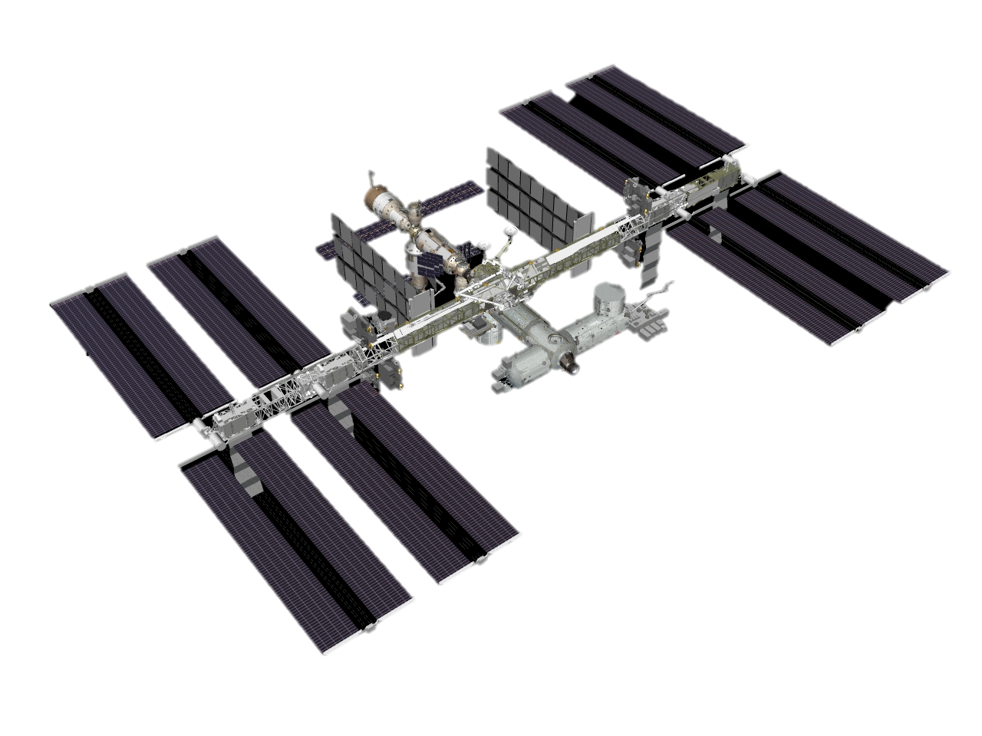




System Architecture
NASA APIs
Mars Rover Photos
InSight: Mars Weather Service API
3D Models
Plugins
Blueprints
Wedges
Static mashes
NASA Discovery Space Shuttle
ISS-International Space Station

Slide 6






Frontend
Backend

Slide 7





Revenue Model
Freemium Service
Collaboration
Advertisement
Royalty Sharing
Free with basic features, along with allowing users to purchase exclusive contents
Collaboration with schools, educational institutions and STEM Programs to license our games as an educational tool, offering bulk licensing or discounted rates to educational partners.
Integrating non-intrusive advertisement or sponsored content into the game, especially if a free version is offered.
The API can be made available to the enthusiasts who can develop games and other services through the app and the royalties from that will be shared
Notes:
7. in order to generate revenue we've built this platform to facilitate freemium services to the customers. Also it features chance to collaboration with educational institutions and STEM programs along with integration of non-intrusive advertisements. We will also make our platform available for royalty sharing under which we will make our API available to the enthusiasts to create and develop really cool things.
8. For this project to get at its feet, we have partnered with these national and international organizations.
9. The revenue model is backed by thorough business analysis, where there is a significantly large market is clearly visible along with some really big names as the competitors.
10. This leads to a sharp growth in revenue year by year.

Slide 8










Partnerships
National
International

Slide 9


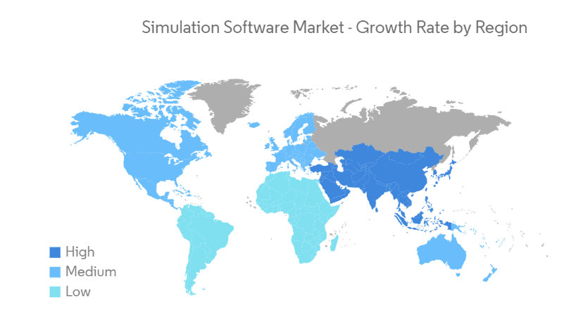



Business Analysis
North America
Largest market
Asia Pacific
Fastest growing market
7.67% annual growth rate by 2027
US$5.90bn
Advertising revenue
US$24.1bn market volume by 2027
12.94bn
Downloads by 2027
US$9.87bn
in app purchase revenue

Slide 10
Revenue Growth
in billions

Slide 11
Thank you!
NASA Challenge:
‘Habitable Exoplanets: Creating Worlds Beyond Our Own’
Team Name: Wormhole_Travellers
Location: Khulna

